Slide 1
Design a rca using domino logic
Under the estimeed guidance of
Sk.MAHAMMAD GOUSE M.Tech
Submitted by,
SK.GOUSIYA 17JE1A0431
G.KANAKA DURGA 17JE1A0440
R.DATTESWARI 17JE1A0421
SK.AYESHA PARVEEN 17JE1A0411
J.CHIRANJEEVI 17JE1A0419

Slide 2
Contents
1.Abstact
2.Static Logic
3.Dynamic Domino Logic
4.Domino Logic
5.Proposed Logic
6.Full Adder
7.Ripple Carry Adder
8.Applications
9.Conclusion

Slide 3
Abstract
1.This paper new design is a proposed logic design targeting at full custom high speed applications.
2.The special features in this enables performance, advantage over static and dynamic, CD logic styles in a single cycle, multi stage circuit block.
3.Using 50nm general purpose CMOS technology, the proposed logic style high performance compare to static, dynamic and CD logic respectively.
4.For ultra high speed applications this circuit design DSCH tool, microwind tool.

Slide 4
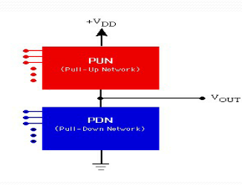
1.It is a CMOS structure
2.Logic functions based on static
3.it has no minimum clock rate
Static logic

Slide 5
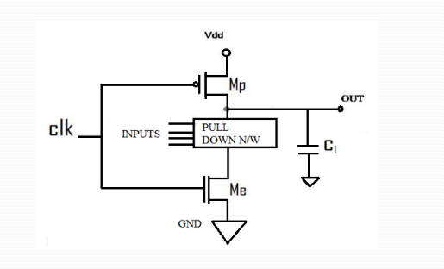
1.Four phase clock is used to derive the clocks
2.the logic is evaluated only in the on period of clock
3.the static power loss is every less in this logic
Dynamic logic

Slide 6
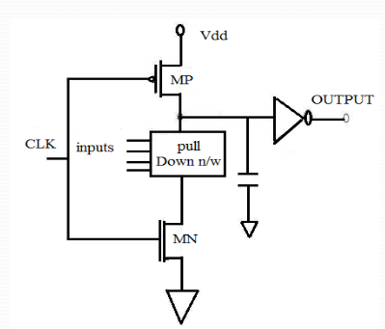
1.domino is a CMOS based evolution of the dynamic logic
2.either pmos or MMOs
3.it allows a rail-to-rail logic swing
Domino logic

Slide 7
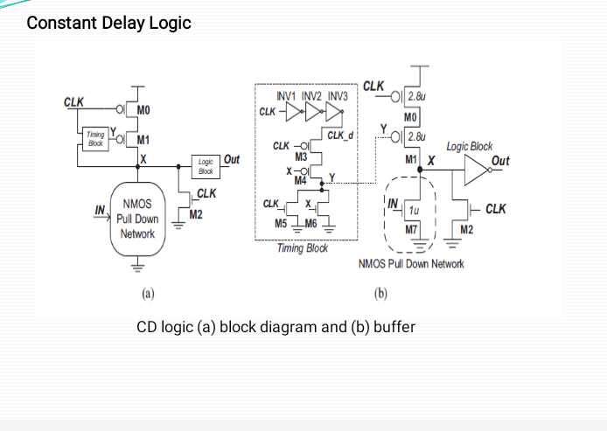

Slide 8
1.It is a new logic style design.
2.Constant delay logic design overcomes the use of more transistors in dynamic domino logic.
3.This logic generates the high speed of operations of possible circuits.

Slide 9
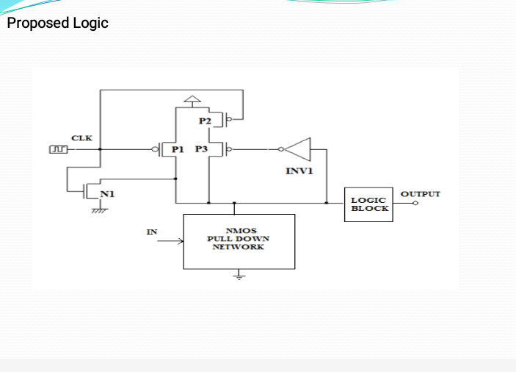

Slide 10
1.This logic gate is idealised model of computation or physical electronic device implementing a Boolean functions.
2.Logic operation performed on one or more binary inputs that produces a single binary output.
3.These gates are made from MOSFETS(metal-oxide- semiconductor-field effect transistors).

Slide 11
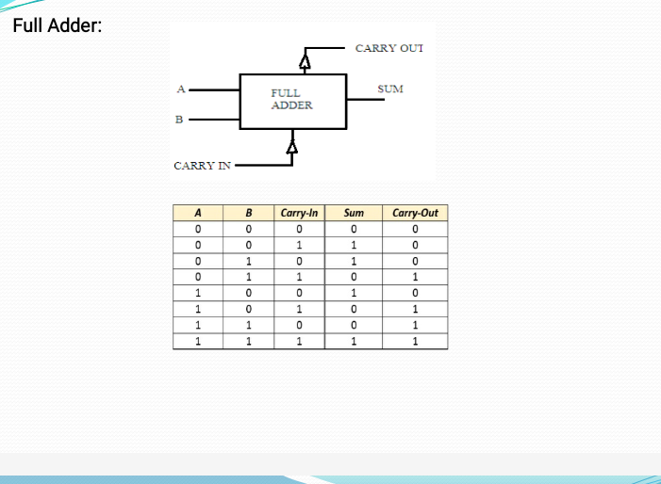

Slide 12
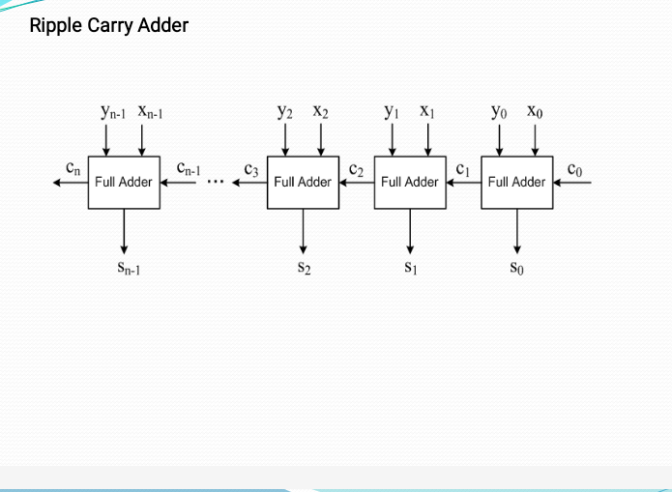

Slide 13
Ripple Carry Adder is a logic circuit in which the carry out of each full adder is the carry in of the succeeding next most significant full adder. It is called a ripple carry adder because each carry bit gets rippled into next stage.

Slide 14
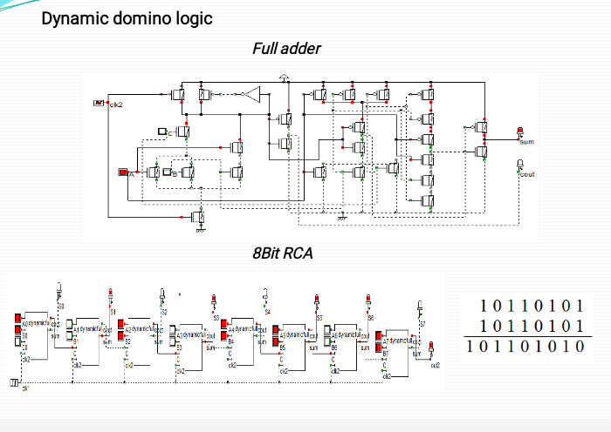

Slide 15
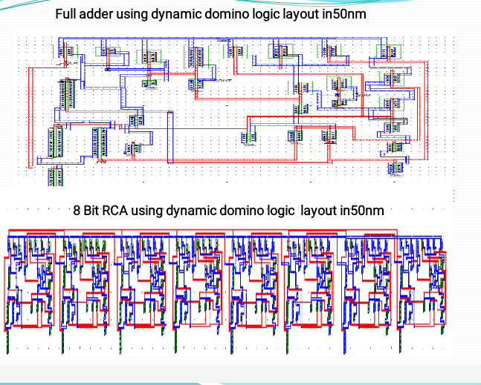

Slide 16
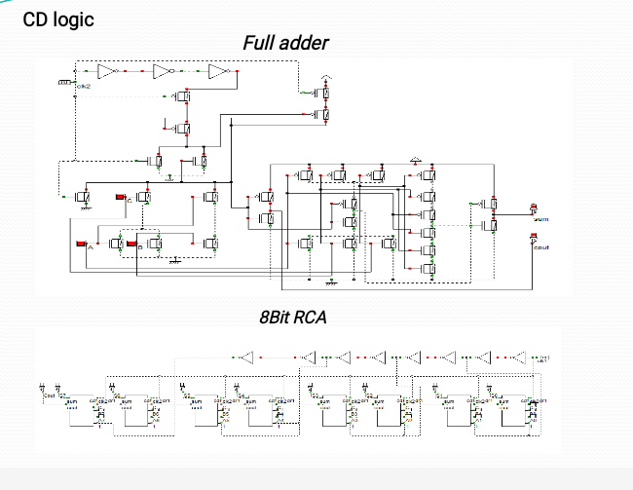

Slide 17
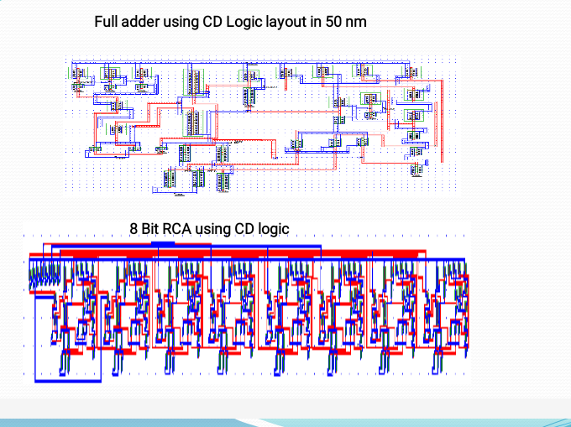

Slide 18
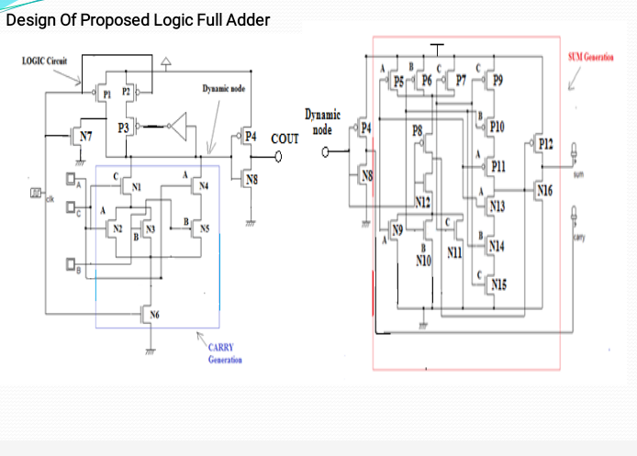

Slide 19
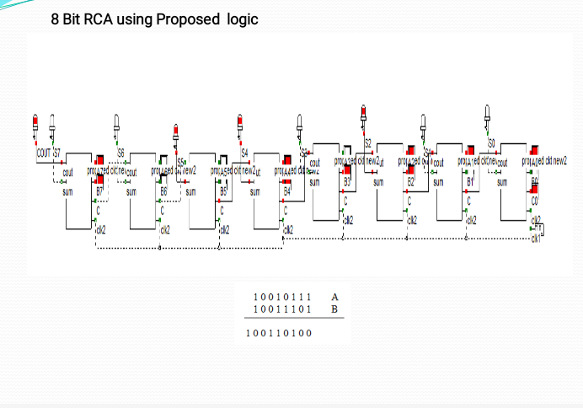

Slide 20
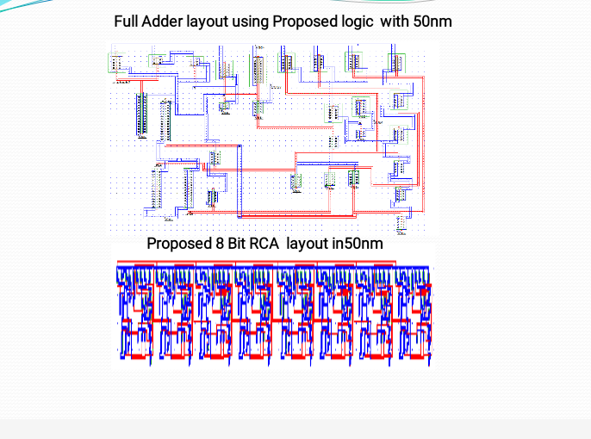

Slide 21
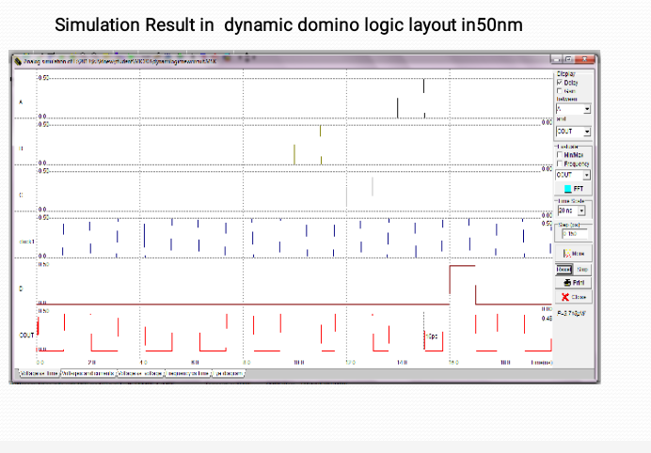

Slide 22
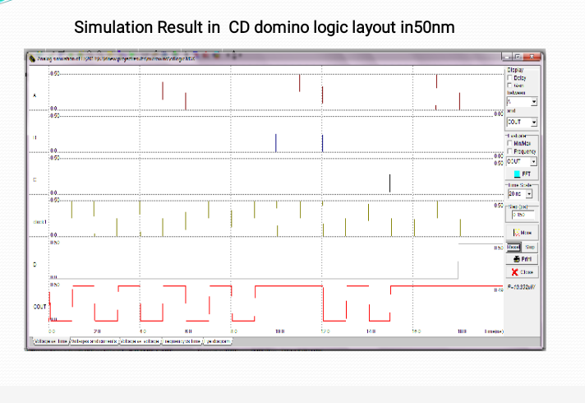

Slide 23
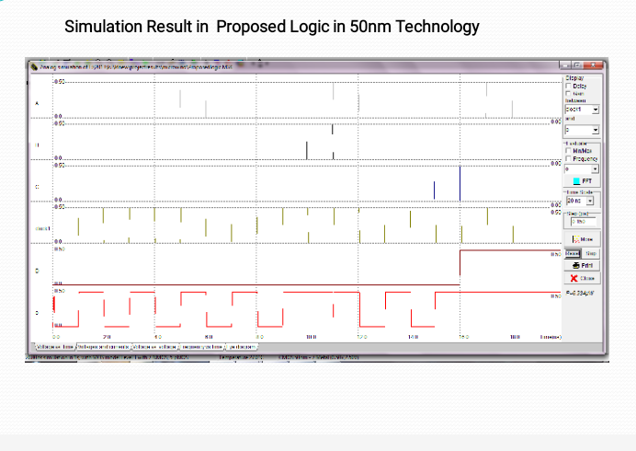

Slide 24
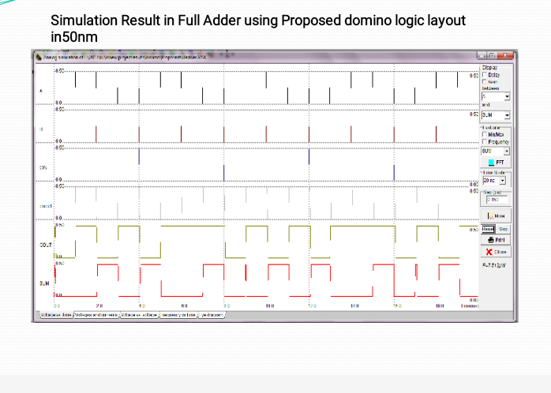

Slide 25
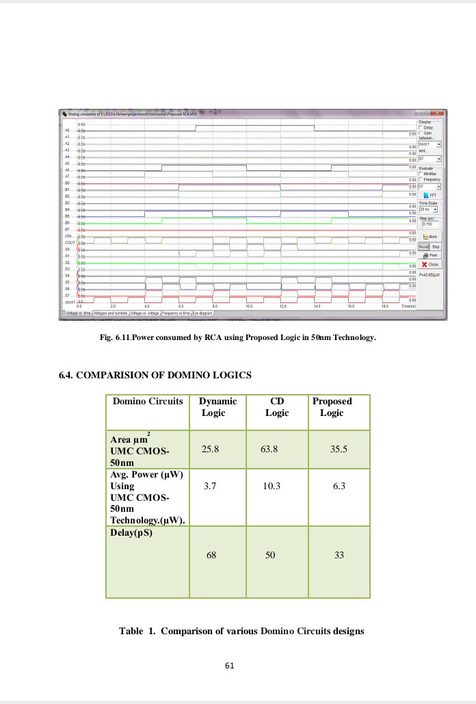
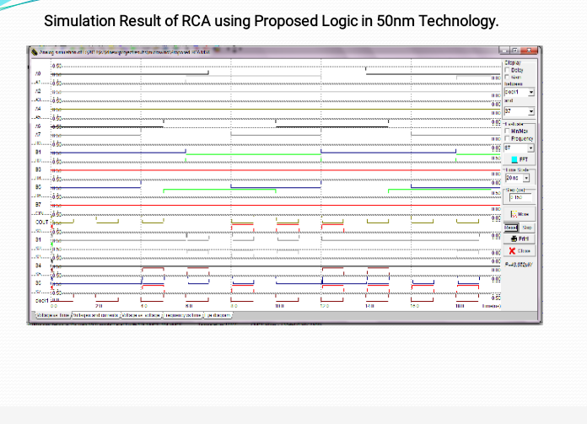

Slide 26
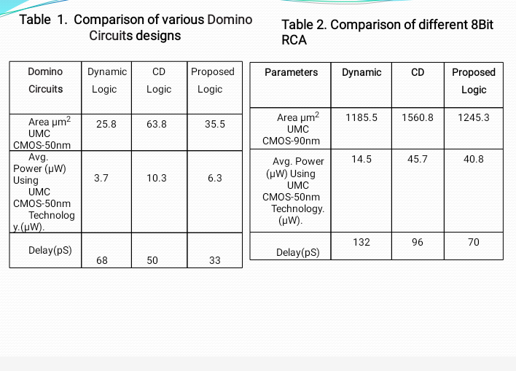

Slide 27
Applications
1.By using this logic we implement the 32 bit RCA .
2.By using this logic we refuse the device count and to increase the speed of performance.

Slide 28
CONCLUSION
1.A new high performance proposed logic style main goal was to make the dominos circuits more robust and with low leakage with out significance performance degradation.
2.Performance analysis of 8 bit RCA reveals that proposed logic is faster than static, dynamic, CD domino logics respectively.
3.A RCA using dynamic full adder, CD logic full adder and proposed logic full ladders are designed in DSCH tool and microwind tool.
4.Verifying the simulation outputs in microwind tools.

Slide 29


